Slide 1
Ch16. Structured Probabilistic Models for Deep Learning
Jaehyoung Hong

Slide 2
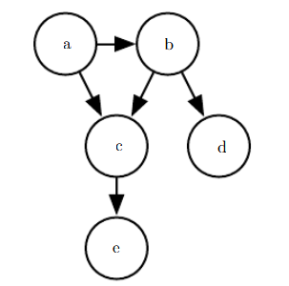
What is structured probabilistic model?
Why?
Factorization of probability distribution
$$p\left(a,b,c,d,e\right)=p\left(a\right)p\left(b | a\right)p\left(c | a,b\right)p\left(d | b\right)p(e|c)$$
Connection & Direction of arrow
When factorization of probability distribution is represented as “graph”,
we call it structured probabilistic model or graphical model.

Slide 3



The probability model need to do a expensive task which is not feasible without structure
Random vector $X=(x_{1},x_{2},…,x_{n})$
Density estimation
Each $x_{i}$ can take $k$ values
Denoising
$$P\left(X\right)?$$
Missing value imputation
Naively, we need $k^{n}$ parameters
Do we really need all of it?
Sampling
Memory
Needed amount of training data
Common tasks which require
a complete understanding of the entire structure
Runtime
Expensive!!!

Slide 4

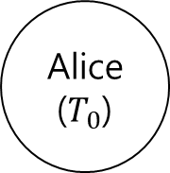
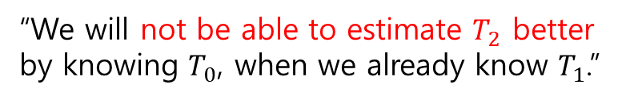


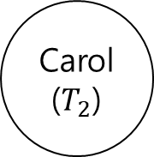

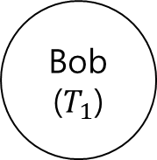
When we consider only direct interaction between variables, models become simpler
How about considering only direct interaction?
“We will not be able to estimate $T_{2}$ better
by knowing $T_{0}$, when we already know $T_{1}$.”
1st runner
2nd runner
3rd runner
Alice
Bob
Carol
Alice
($T_{0}$)
Bob
($T_{1}$)
Carol
($T_{2}$)
$$T_{0}$$
$$T_{1}$$
$$T_{2}$$
Dummy (Can omit)
Not depend on anyone
Depend on Alice
Depend on Bob (direct) & Alice (indirect)
Graphical model : Formal framework for modeling only direct interaction

Slide 5
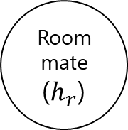
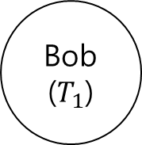
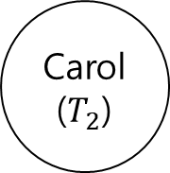
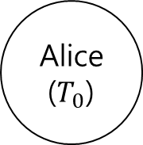
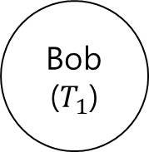
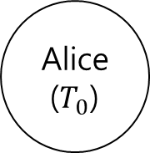
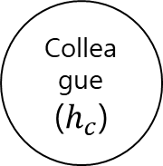
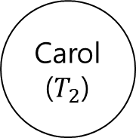
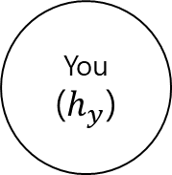
Graphical model use graphs (nodes & edges) to represent interactions between random variables
Graph
Alice
($T_{0}$)
Edge
Bob
($T_{1}$)
Edge
Carol
($T_{2}$)
Each node represents a random variable
Each edge represents a direct interaction
Node
Node
Node
Graphical models based on two types of graphs
Alice
($T_{0}$)
Bob
($T_{1}$)
Carol
($T_{2}$)
Roommate
($h_{r}$)
You
($h_{y}$)
Colleague
($h_{c}$)
Directed acyclic graph
Undirected graph

Slide 6

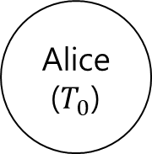
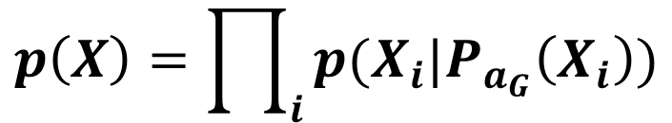

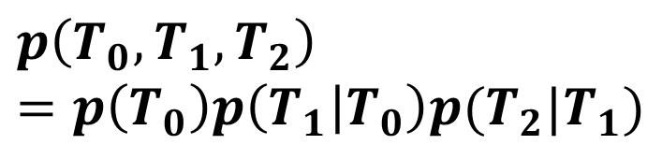
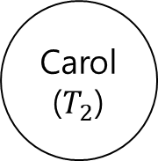
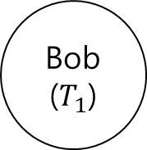

Directed model represents ‘parents’ and ‘daughters’
a
b
We’ll consider
$$p(b|a)$$
Parent
Daughter
Alice
($T_{0}$)
Bob
($T_{1}$)
Carol
($T_{2}$)
$$p\left(T_{0},T_{1},T_{2}\right)=p\left(T_{0}\right)p\left(T_{1} | T_{0}\right)p(T_{2}|T_{1})$$
Only parents, not grand parents
For variables $X$ and directed acyclic graph $G$
$$p\left(X\right)=\prod_{i}{p(X_{i}|P_{a_{G}}\left(X_{i}\right))}$$
,where $P_{a_{G}}(X_{i})$ gives the parents of $X_{i}$ in $G$

Slide 7
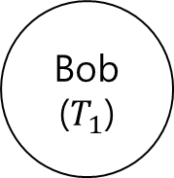
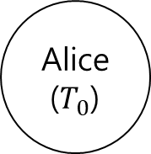
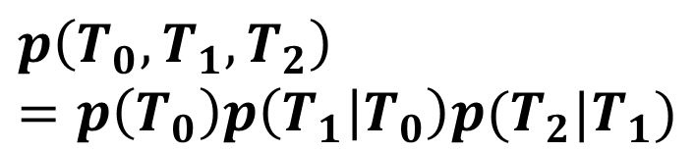
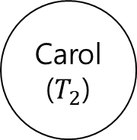
As long as each variable has few parents in the graph, it can reduce cost
Alice
($T_{0}$)
Bob
($T_{1}$)
Carol
($T_{2}$)
$$p\left(T_{0},T_{1},T_{2}\right)=p\left(T_{0}\right)p\left(T_{1} | T_{0}\right)p(T_{2}|T_{1})$$
Only parents, not grand parents
Suppose we represented time by discretizing time ranging from minute 0 to minute 10 into 6-second chunks (100 possible values).
Naïve approach to represent $P(T_{0},T_{1},T_{2})$
$100$ values of $T_{0}× 100$ values of $T_{1}× 100$ values of $T_{2}−1=999,999 values$
Using graphical model to represent $P(T_{0},T_{1},T_{2})$
$99$ values of $T_{0}+9900$values of $T_{1}$ given $T_{0}+9900$ values of $T_{2}$ given $T_{1}=19,899 values$

Slide 8
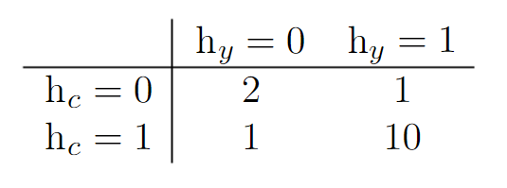

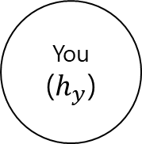
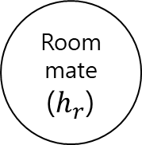
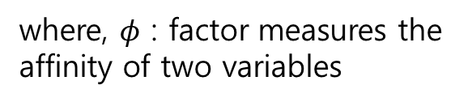
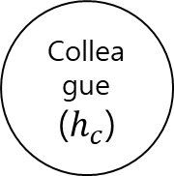

Undirected graph is used when the causality is bidirectional or not clear
Whether or not sick
Roommate
($h_{r}$)
You
($h_{y}$)
Colleague
($h_{c}$)
We can know colleague and roommate
does not know each other (no direct interaction)
$$\tilde{p}\left(h_{r},h_{y},h_{c} \right)=φ\left(h_{r},h_{y}\right)φ(h_{y},h_{c})$$
where, $φ$ : factor measures the affinity of two variables
$$\tilde{p}\left(X\right)=\prod_{C∈G}{φ(C)}$$
$$φ$$
where, C : clique of the graph

Slide 9
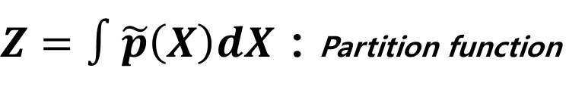

The Partition function is sum over all possible joint assignment of the state
$$\tilde{p}\left(X\right)=\prod_{C∈G}{φ(C)}$$
$Z=∫\tilde{p}\left(X\right)dX$ : Partition function
Not guaranteed to sum or integral to 1
Z is difficult to compute
In the context of deep learning, Z is usually intractable → Approximation
2. Sometimes Z does not exist
$x$ is scalar variable in real number, $φ\left(x\right)=x^{2}→Z=∫x^{2}dx$ diverge
Existence of Z is depend on the domain of variable

Slide 10
Separation defined in a undirected graph shows conditional independence in a graph
Separation defined in a undirected graph : Implying conditional independence
a
s
b
a
s
b
Shaded circle : Observed variables
We call paths involving only unobserved variables as “active”
We call paths including an observed variables as “inactive”
a and b are not separated
a and b are separated (given s)

Slide 11
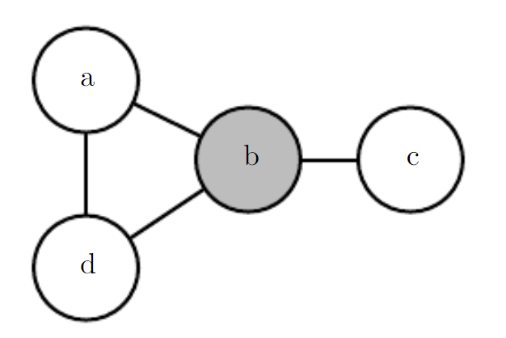
Separation defined in a undirected graph shows conditional independence in a graph
Separation defined in a undirected graph : Implying conditional independence
Yes
a and c are separated?
Yes
c and d are separated?
No
a and d are separated?
Find active path

Slide 12
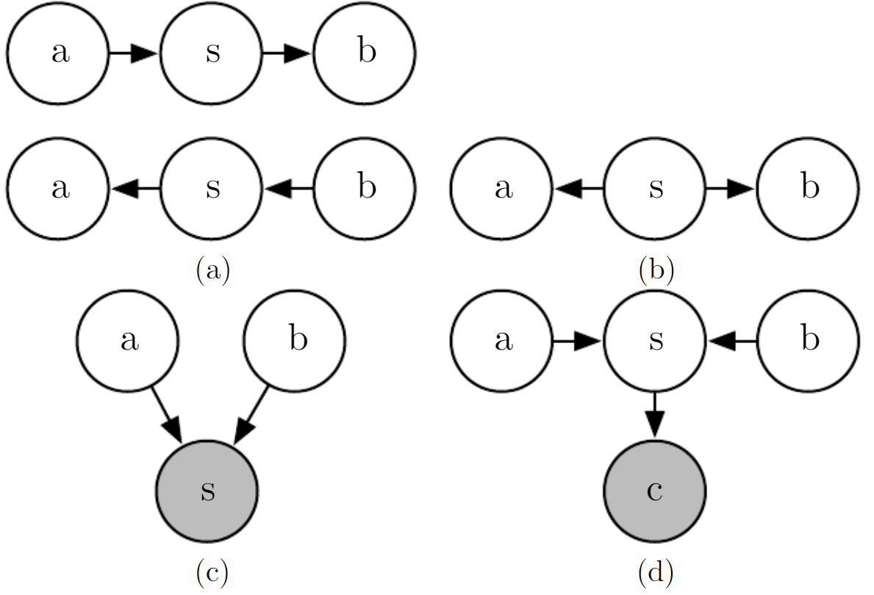
D-Separation defined in a directed graph shows conditional independence in a graph
D-Separation defined in a directed graph : Implying conditional independence
Find ‘active’ path !! But more complicated
No
a and b are d-separated?
a and b are d-separated
when s is observed?
Yes

Slide 13
D-Separation defined in a directed graph shows conditional independence in a graph
D-Separation defined in a directed graph : Implying conditional independence
Find ‘active’ path !! But more complicated
No
a and b are d-separated?
(When a occurs, we can guess b occurs)
a and b are d-separated
when s is observed?
Yes

Slide 14
D-Separation defined in a directed graph shows conditional independence in a graph
D-Separation defined in a directed graph : Implying conditional independence
Find ‘active’ path !! But more complicated
No
a and b are d-separated?
(s : absence, a : vacation, b: sick
If ~s we can infer ~a and also ~b)
a and b are d-separated
when s is not observed?
Yes
V-structure

Slide 15
D-Separation defined in a directed graph shows conditional independence in a graph
D-Separation defined in a directed graph : Implying conditional independence
Find ‘active’ path !! But more complicated
No
a and b are d-separated?
(s : absence, a : vacation, b: sick & c : report
If ~c we can infer ~s and
hence can infer ~a and also ~b)
a and b are d-separated
when s is not observed?
Yes

Slide 16
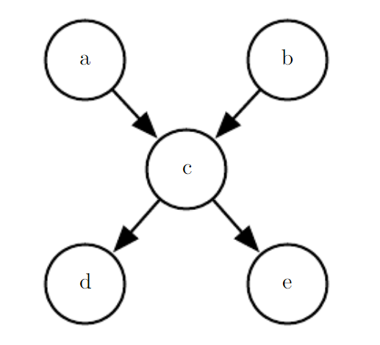
D-Separation defined in a directed graph shows conditional independence in a graph
D-Separation defined in a directed graph : Implying conditional independence
Find ‘active’ path !! But more complicated
a and b are d-separated given the empty set
a and e are d-separated given c
d and e are d-separated given c
a and b are not d-separated given c
a and b are not d-separated given d

Slide 17
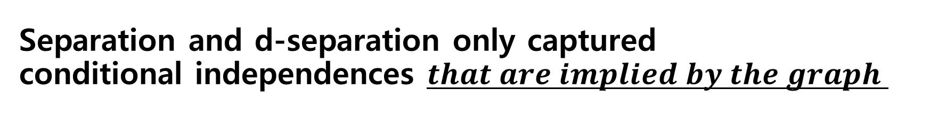
Separation and d-separation only captured conditional independences $that are implied by the graph$
Context-specific independences which are independences that are present dependent on the value of some variables in the network
→ Cannot captured by separation and d-separation
$$e.g) Three binaray variables :a, b and c$$
When $a=0$, $b$ and $c$ are independent
When $a=1$, $b=c$
Encoding $a=1$ requires edge between $b$ and $c$
Such graph fails to indicate that $b$ and $c$ are independent when $a=0$

Slide 18
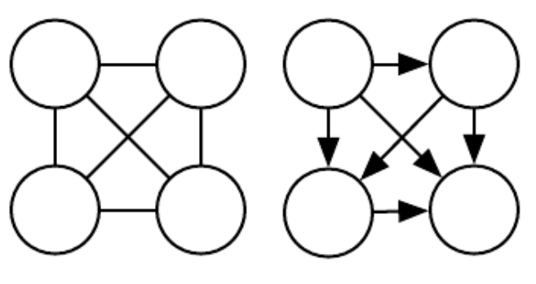
Directed model and undirected models both have their advantages and disadvantages
Neither approach is clearly superior and universally preferred.
Choose one which can be efficiently describe probability distribution which we want to handle
Directed model : Provides efficient approach to draw samples from the model
Undirected model : Useful for deriving approximate inference procedure (Ch.19)
Every probability distribution can be represented by either a directed model or undirected model
Example : Complete graph (worst case)

Slide 19
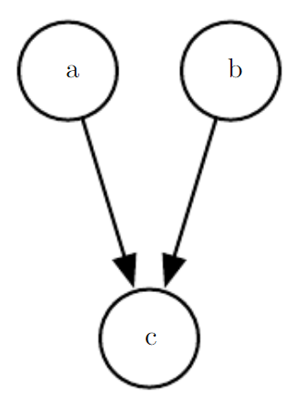
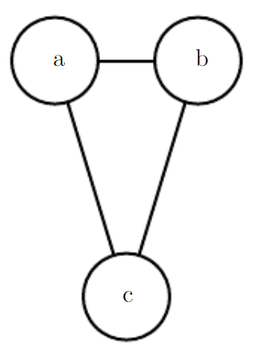
“Immorality” structure can only represent perfectly by directed model
Immorality : $a$ and $b$ are both parents of $c$, while no edge directly connecting $a$ and $b$
Moralized graph
Lose independence
Converting into an undirected model

Slide 20
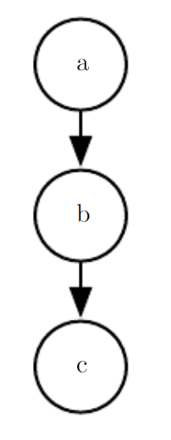
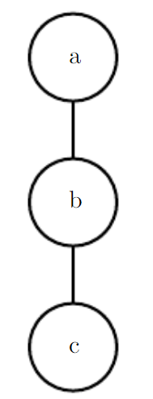
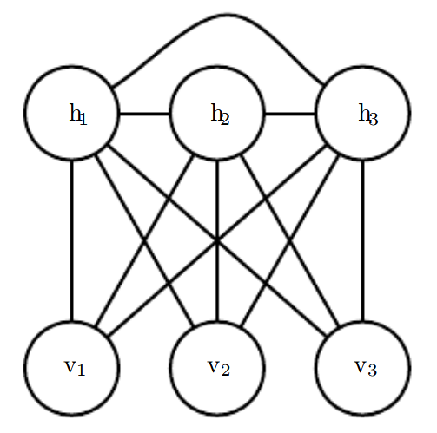
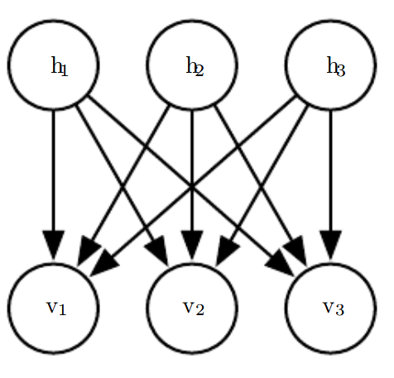
Examples of converting directed models to undirected models by constructing moralized graph
Moralization
Moralization
Losing many independence

Slide 21
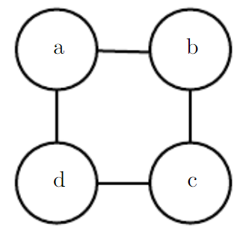
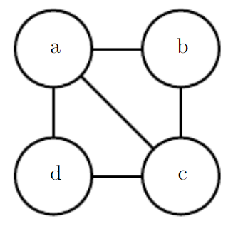
“Loop (length > 3) without chord” structure can only represent perfectly by undirected model
Loop : The last variable in the sequence connected back to the first variable in the sequence
Chord : Connection between any two nonconsecutive variables in the sequence defining a loop
<Loop>
<Chord>

Slide 22
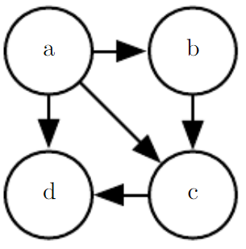
Examples of converting undirected models to directed models by triangularization
Triangulated
/ Chordal
Converting into directed model
Losing independence

Slide 23
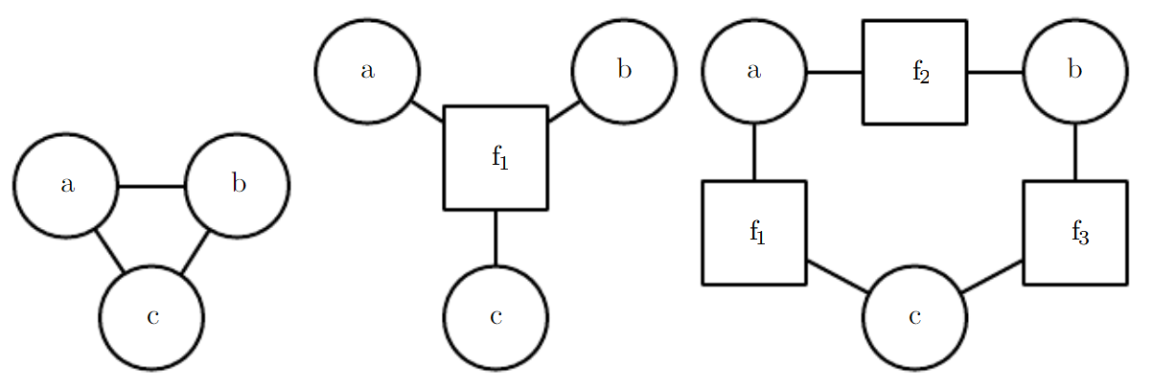



Factor graph is a graphical representation of an undirected model that consists of a bipartite undirected graph
$$p=f_{1}\left(a,b\right)f_{1}\left(b,c\right)f_{1}(c,a)$$
$$p=f_{1}\left(c,a\right)f_{2}\left(a,b\right)f_{3}(b,c)$$
In previous framework, three graphs are same undirected graph
Representation / inference / learning are cheaper
Factor graph (center) : Having one factor $f_{1}$for all three variables
Factor graph (right) : Having three factors $f_{1},f_{2} and f_{3}$for each two variables

Slide 24
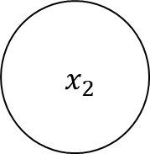
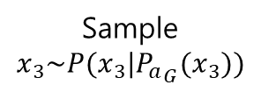
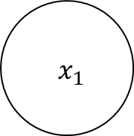
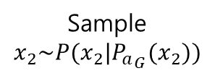

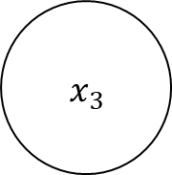
Graphical models facilitate the task of drawing samples from a model
Ancestral sampling : Sample from the joint distribution represented by the model
$${ x}_{1}$$
$${ x}_{2}$$
$${ x}_{3}$$
…
Topological ordering
Sample $x_{1}\sim P(x_{1})$
Sample $x_{2}\sim P(x_{2}|{P_{a}}_{G}(x_{2}))$
Sample $x_{3}\sim P(x_{3}|{P_{a}}_{G}(x_{3}))$
Ancestral sampling is generally fast assuming sampling from each conditional is easy
Disadvantage 1. Only applies to directed graphical models → Gibbs Sampling
Disadvantage 2. It does not support every conditional sampling operation

Slide 25
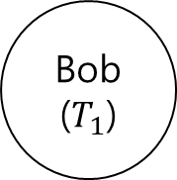


Advantages of structured modeling : Choose interaction & separate representation from learning
Alice
($T_{0}$)
Bob
($T_{1}$)
Carol
($T_{2}$)
Separation of representation of knowledge from learning of knowledge or inference given existing knowledge
Dummy (Can omit)
Graphical model : Formal framework for modeling only direct interaction
e.g.) “Learning / inference algorithm for broad classes of graphs” + “Models that capture the relationships we believe are important in our data”
We can use less runtime and memory by using only interaction represented by edges in the graph

Slide 26









Considering deep learning as structured generative model with latent variables
Given observed (“visible”) variables $v$, accurately capture the distribution $p(v)$ is important
(Different elements of v are highly dependent on each other → Learning about dependencies)
Deep leaning : learning dependencies by “hidden” (latent) variables
$${ v}_{1}$$
$${ v}_{2}$$
$${ v}_{3}$$
e.g.) $v_{1}$ and $v_{2}$ → $v_{1}$ and $h$ + $h$ and $v_{2}$
Latent variables instead of adaptive structure avoids complex training
$${ h}_{1}$$
$${ h}_{2}$$
$${ h}_{3}$$
$${ h}_{3}$$
Latent variables provide an representation of $v$ via $h$, which provides feature learning
Graph structure efficiently capture such dependencies
e.g.) $E\left[h | v\right]$or${argmax}_{h}p(h,v)$→inference problem

Slide 27
Deep graphical models versus traditional graphical models
Deep graphical models
Traditional graphical models
A lot of latent (“hidden”) variables
Few latent (“hidden”) variables
Does not intend for the latent variables to take on any specific semantics
(Usually not easy to interpret)
Designed with some specific semantics in mind (e.g. : the disease causing a patient’s symptoms)
Dense connection
(Inference is intractable → Gibbs sampling & variational inference)
Sparse connection
(Loopy belief propagation)
Rather than simplifying the model until all quantities we might want can be computed exactly,
we increase the power of the model until it is just barely possible to train or use)

Slide 28








Example : The Restricted Boltzmann machine (RBM)
RBM is not itself a deep model (single layer of latent variables), but it can be used to build many deeper models
$$\tilde{p}\left(v,h\right)=exp⁡(−E\left(v,h\right))$$
$$E\left(v,h\right)=−b^{T}v−c^{T}h−v^{T}Wh$$
$$p\left(h | v\right)=\prod_{i}{p(h_{i}|v)}$$
Make training convenient
$$p\left(v | h\right)=\prod_{i}{p(v_{i}|h)}$$
Efficient Gibbs sampling
$$P\left(h_{i}=1 | v\right)=σ(v^{T}W_{:,i}+c_{i})$$
$$P\left(v_{i}=1 | h\right)=1−σ(W_{i,:}h+b_{i})$$
$$where σ\left(x\right)=1/(1+e^{−x})$$
Direct interactions between $v_{i}$and $v_{j}$ does not exist
$$\frac{∂}{∂W_{i,j}}E\left(v,h\right)=−v_{i}h_{j}$$
Efficient derivatives
Direct interactions between $h_{i}$and $h_{j}$ does not exist

